Slide 1

School DISTRICT strikes
A Data-Driven Investigation
Contributors: Emily Todd, Prashant Ganorkar,
Michelle Cascio & Juluo DeCastro

Slide 2

7 School districts
5 states
Denver
Detroit
Jersey City
Los Angeles
Oakland
New Haven
Tacoma
Arizona
Colorado
Kentucky
Oklahoma
West Virginia
From Bureau of Labor Statistics

Slide 3
Metrics Data Collection
Metrics
Issues
NCES: National Center for Education Statistics
Searchable database called “Elementary and Secondary Information System” allows for CSVs to be easily downloaded
Latest data reported is 2017
The database includes over 19,000 districts. We omitted districts with fewer than 1,000 students and those not reporting on our metrics with the exception of:
Districts within Utah and Colorado did not report on % of IEPs, so we inserted their respective state average for this missing data point.

Slide 4
Challenges Bringing the data Together
Inconsistent large data sets
Couldn't just merge the data sets together
Test score data nearly impossible to retrieve for 6200+ school districts.
Investigating striking school districts
CA vs US
Incorporation of teacher’s salary
Needed relative to their cost of living

Slide 5
Measuring metrics for strikes:
Total # of Students Enrolled | % of Charter Schools in the District | % of ELL Students (English Language Learners) | % of IEP Students (Individualized Education Plan, i.e. Special Education) | Student Teacher Ratio | % of Students Living in Poverty (Free & reduced lunch students) | Expenditure to Revenue Ratio

Slide 6







Tools:

Slide 7
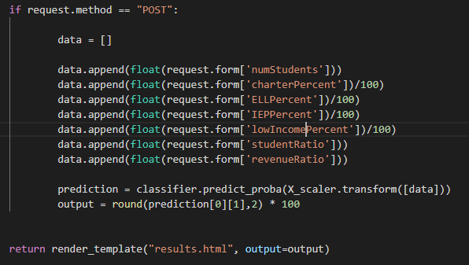
Flask app
User inputs numbers for our 7 key metrics
Flask route uses those inputs to predict the probability of a strike

Slide 8
demo

Slide 9
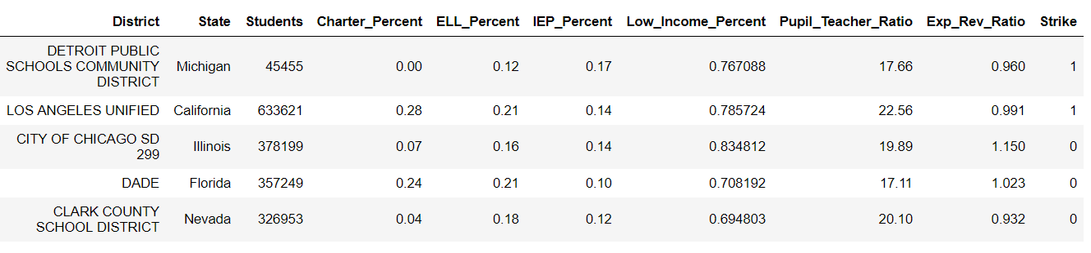
Process --> Logistic regression
Can we predict a binary outcome (y) from our data set (x)?
Strike = 1 No Strike = 0

Slide 10
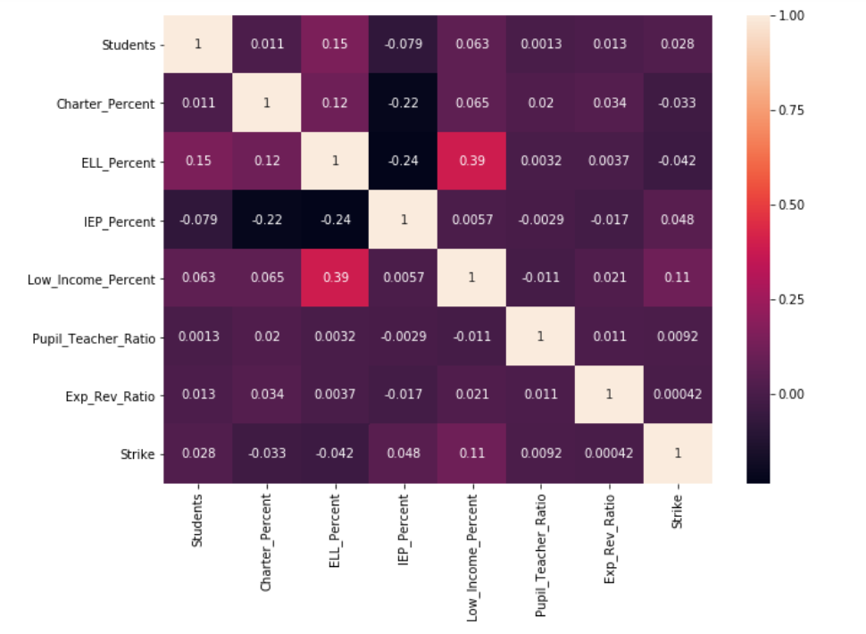
Correlation matrix
Do individual variables show any correlation?
Positive Correlations
a) % of ELLs and % of students in poverty have a moderate positive correlation.
Negative Correlations
a) % of students in Special Education and % of ELLs have a moderate negative correlation.
b) % of students in Special Education and % of Charter schools have a moderate negative correlation.

Slide 11
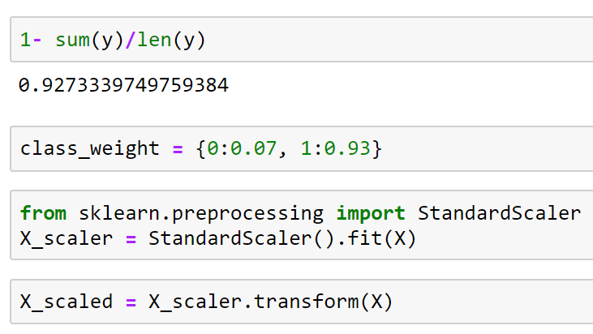
Class & Weight Source
How did we manage imbalanced classes?
Only 7% of the total data set is designated a “Striking District” based on 3-year historical data.
We applied class weights to counter the imbalance.
Then, we scaled our values before training the data.

Slide 12
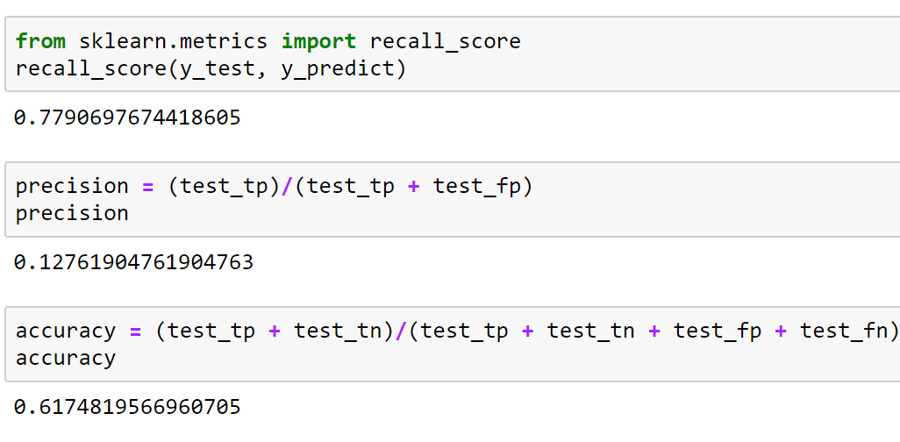
PERFORMANCE METRICS
Recall (78%), Precision (13%) and Accuracy (62%) Measures:

Slide 13
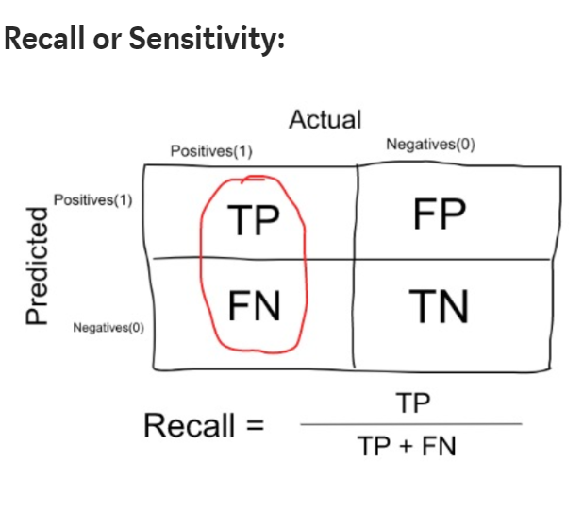
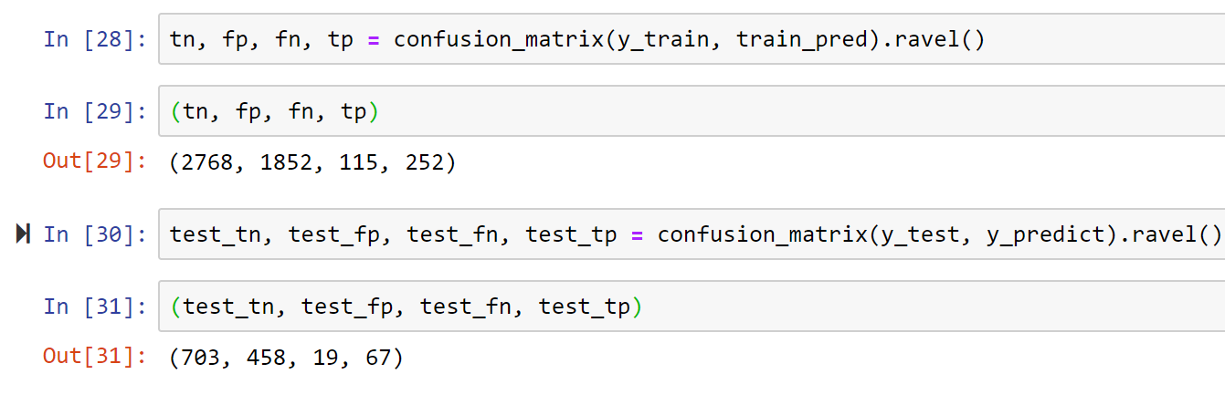
Confusion Matrix
The best measure of our classification model’s performance is Recall because we want to minimize false negatives (FN).

Slide 14

Conclusion/recommendations:
Real world problem with potential to further optimize the model

Slide 15
THREE V’s:
Volume: More features could be included : Test score Teacher salary/cost of living, Education background of family etc. | Variety: only seven district/Five State went on strike to date. | Velocity: Frequency of teacher going on strike is low
Models: Support vector machine (SVM) as data is limited
Use grid search to fine tuning of hyper parameters(learning rate, class weights, Optimizer type)
Cross validation: Can be generalized

Slide 16
Potential School Management Tool (Cont.):
A proactive approach rather than Reactive approach
Cultural assessment tool: Helps with retention level, school rating, students wellbeing etc.
Keep on the pulse of the school as it is a moving target….

Slide 17
Thank you!

